Slide 1
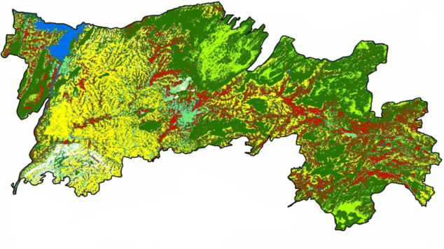


Title: Radiation level in Salem district From - 2022 | Map description and analysis
Data courtesy: BHUVAN, Salem Region | Introduction: The Salem metropolitan Area is the 56th most populous metropolitan area in India. It is the 4th populous metropolitan area in Tamil Nadu, Salem has 124km2(48sq mi).
 |  | 2021 |  | 2022
 |  | WATER BODIES: Mookaneri lake also called Kannankurichi lake is a lake in Kannankurichi in the Salem taluk which covers an area of 23.5 hectares. 2.The Thirumanimutharu river originates from Manjavadi village in the shevaroy mountain range and flows through the Salem and Namakkal districts of the Indian state of Tamil Nadu . MOUNTAINS: Yercaud is a hill station near Salem in the Shervaroy range of hills in the eastern ghats. It is at an altitude of 1515 meters above the see level. The total extend of Yercaud taluk is 382.67sq.popular as the Ooty of poor peoples. FOREST: The total geographical area of 523700.60 Ha, cultivated area is 220138 ha and the net area shown is 210562.54 ha to the percent of 65.74% and 10.34% and area sown more than once is 208128.15 ha percent of 1% respectively. CONSTRUCTIONS: The Salem metropolitan Area is the 56th most populous metropolitan area in India.it is the 4th populous metropolitan area in Tamil Nadu. Salem has 124km2(48sq mi). Metropolitan Area=588.94km² 2.Urban =100km² 3.metro =575.87km^{S} |  | WATER BODIES: Mookaneri lake also called Kannankurichi lake is a lake in Kannankurichi, in the Salem taluk which covers an area of 23.2 hectares. HILLS: Yercaud is a hill station near salem in the shevaroy range of hills in the eastern ghats. It is at an altitude of 1515 meters above the sea level. The total extend of Yercaud taluk is 382.69sq.popular as the Ooty of poor peoples. AGRICULTURAL LANDS: The total geographical area of 520530.82 Ha, cultivated area is 282310.41 ha and the net area shown is 204782.82 ha to the percent of 54% and 39% and area shown more than once is 77527.59 ha percent of 0.14% respectively. COUNSTRUCTIONS: The Salem metropolitan Area is the 56th most populous metropolitan area in India. It is the 4th populous metropolitan area in Tamilnadu .Salem has 124km2(48sq mi). Metropolitan Area =799.59km2 2.Urban =124km2 3.Metro =675.59km2
 |  |  | Team Name: SOCIATRONS
 |  |  | Topic: Radiation level
 |  |  | Team member/lead: SURYA NARAYANAN CS
 | Organization: Sona College of Technology
 | Contact/email: cssuryanarayanan2k2@gmail.com
CONFISTICATED/CLOSED ZONE
Greater than 40 ci/km
PERIODIC CONTORLLED ZONE
15-40 ci/km
PERMANENT CONTROL ZONE
5-15 ci/km
UNNAMED ZONE
1-15 ci/km

